Slide 1





Introduction to SEO
What is Search Engine Optimization (SEO) and How It Works?
Svetlin Nakov
Senior Technical Trainer
Telerik Corporation
www.telerik.com

Slide 2


Table of Contents
What is SEO?
How the Search Engines Work?
SEO Step-by-Step
Clarifying the SEO Goals
SEO Assessment & Metrics
SEO-Friendly Web Sites
Copywriting
Link Building
Social SEO

Slide 3


Table of Contents (2)
Online Reputation Management (ORM)
SEO Tools
Microformats / Rich Snippets
Special Search Channels
Video / Images / Local Search / Mobile Search
Black and White SEO
Paid SEO / AdWords
Link Bait (Viral) SEO
Google Panda / Penguin

Slide 4
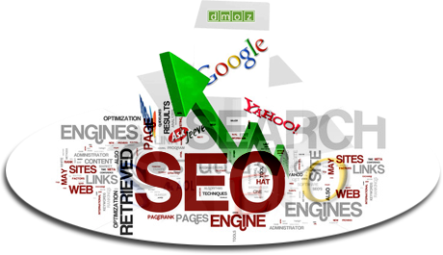




What is SEO?
Search Engine Optimization

Slide 5
What is SEO, SEM, E-Marketing?
Search engine optimization (SEO)
The process of improving the visibility of a Web site or a Web page in the search engines
SEM – search engine marketing means marketing of a Web site (SEO + paid ads)
Internet marketing (Web marketing, e-marketing)
Marketing a product or service through Internet
Includes SEO, SEM, SMM (campaigns in the social networks), paid ads, e-mail marketing, …

Slide 6

Goals and Benefits of SEO
Goals of SEO (and e-marketing in general)
The Web site / page is shown at the top positions in Google / Bing / Yahoo
For certain keywords and search phrases
The Web site / page increases its visitors (customers) and increases its sales
Achieve better branding and reputation for a product / service
Target the audience better
Cut the marketing costs

Slide 7

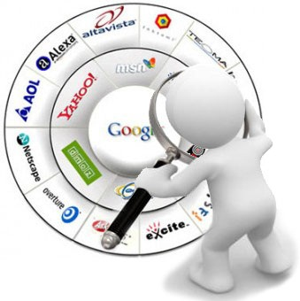

How the Search Engines Work?
General Principles of the Search Engines

Slide 8
Global Search Engines
As of 2013 the world's most popular global search engine is Google
Search engines market share (May 2013) *
Google – 80-90%
Bing (Microsoft) – 4-5%
Rebranded "Live Search", "MSN Search"
Yahoo (Microsoft) – 2-3%
Ask.com, Lycos.com, Search.AOL.com and the others are very weak
* Source: http://www.karmasnack.com/about/search-engine-market-share/

Slide 9
Special Search Engines
Local search engines have big market share in some countries
Baidu in China – 70%-80% market share
Yandex in Russia – 60%-70% market share
Meta-search engines
Excite.com, HotBot.com, Info.com, …
Domain-specific search engines
Blog Search: www.google.com/blogsearch
People Search: people.yahoo.com, pipl.com

Slide 10
How Search Engines Work?
Search engines have a Web spider
Automated software that crawls the Web and indexes all pages it finds
Search engines have a ranking algorithm
Complicated logic that ranks the sites and pages based on content, links and other factors
Google PageRank depends on the quantity and quality of the external links to it (backlinks)
No one knows how exactly Google works
Its search algorithms change every day

Slide 11
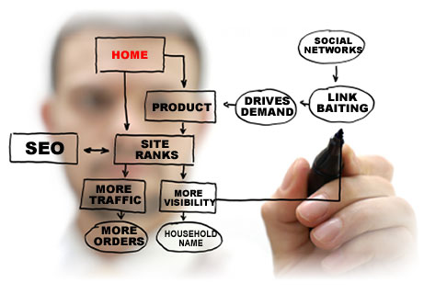
SEO Step by Step
General Guidelines for Performing SEO

Slide 12
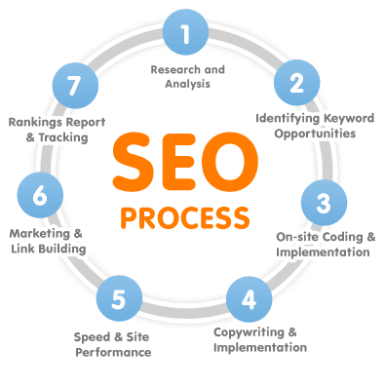
SEO Typical Activities
Most SEO projects includes the following typical activities:
Clarifying the SEO goals
SEO assessment & metrics
On-site SEO
Copywriting
Link building
Social SEO
Local search SEO

Slide 13




Clarifying the SEO Goals
Keywords, Competitors, Goals

Slide 14
Clarifying the SEO Goals
Define your SEO goals
What I want to achieve?
E.g. double my site visitors / subscribers / sales
E.g. enter in the top search results in Google for certain keywords / phrases
Identify your keywords / phrases for SEO
What phrases do you need to optimize?
Analyze your competitors
Who are they? Why they are well ranked?

Slide 15



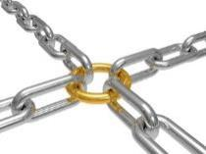
SEO Assessment & Metrics
How to Measure the Success in the SEO World?

Slide 16
SEO Assessment & Metrics
To measure the success in the SEO world we need some metrics
Metrics show how close we are to our SEO goals
Keyword-specific metrics
Measure the page position in SERP in Google / Bing / Yahoo for each target keyword / phrase
Users rarely open the second page of the search results → your site should be at the first
Position after 20-30 is de-facto useless
Can still be measured for tracking the changes

Slide 17
General SEO Metrics
Popular SEO metrics for a Web site:
Google Page Rank / Alexa Rank / mozRank / Complete Rank
# of visitors per day (average traffic)
# of external links to your site (backlinks)
# of root domains linking to your site
# of Twitter / Facebook / Google+ followers
# of indexed pages in Google / Yahoo / Bing
Conversion rate (visitors → subscribers → trial users → paid users)

Slide 18



SEO-Friendly Web Sites
Site Architecture, Structure, Internal Links, etc.

Slide 19
Building a SEO-Friendly Site
The quality of your site content, structure, internal links, etc. is very important for SEO!
Known as on-site SEO / SEO-friendly site
E.g. if your keywords are missing on your Web site, Google considers it irrelevant
Be sure to insert your keywords and phrases on the page titles, subtitles, sidebars, footers, etc.
Carefully prepare your content and internal links anchors, measure keywords density
Use tags and categories for content annotation

Slide 20
SEO-Friendly Platforms
CMS platforms like WordPress, Joomla, Drupal
SEO-friendly out-of-the-box + lots of SEO plugins
Support SEO-friendly URLs, tags, categories, internal linking, canonical URLs, etc.
Popular online blog platforms like Blogger, WordPress.com, Tumblr, Posterous
SEO-friendly out-of-the-box
Build your own SEO platform
Costs too much resources → for experts only

Slide 21




SEO-Friendly Platforms
Live Demo

Slide 22

Copywriting
How to Write and Publish High Quality Content?

Slide 23
Copywriting
Copywriting is the process of authoring high-quality marketing text or other content
To promote a site / product / service / idea / etc.
Articles, blog posts, Facebook posts, etc.
Copywriting for SEO means to write an article
With high density of the target keywords
With one or more backlinks to your Web site
With specific anchor text in the links
That targets general or specific audience

Slide 24
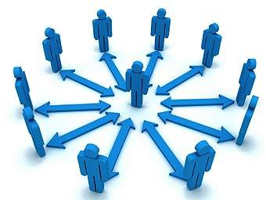



Link Building
How to Create Backlinks to Your Site?

Slide 25
Link Building
Link building is the process of building high-quality unidirectional backlinks to your site
High-quality links means:
Links from popular, highly ranked web sites
Sites from the same business domain
Sites, blogs and directories on similar topics
Social networks and groups on similar topics
Organic, natural links, not spam!
Only "DoFollow" links matter

Slide 26
The Link Building Process
Most popular link building techniques
Publishing high-quality articles in blogs, article directories, sites, forums or other pages
Backlinks from directories, social bookmarking sites and social networks
Links from comments in blogs and forums
One-way links from sites on similar topics
Satellite sites on the same topic which give additional PageRank flow to your main site
Creating a "link bait" content

Slide 27




Social SEO
Using the Social Media Networks for SEO

Slide 28
Social Media Optimization
Social media optimization (SMO, social SEO)
Attracting visitors from the social networks
Typical social SEO activities
Share content in the social networks, social integrate comments, likes , "+1" in your site
Post your media in the social sites (images, video, presentations, etc.)
Maintain pages / groups / lists / … of your site
Post articles / comments / messages about your site in blogs, forums, groups, social networks, …

Slide 29

Online Reputation Management (ORM)

Slide 30
Online Reputation Management
Online reputation management (ORM)
Monitoring the Internet reputation of a person / product / brand / business
With the goal of suppressing negative mentions
Or pushing them lower on the search engines
Two activities:
Monitoring – done by ORM monitoring tools
Mitigation – mitigating SERPs (search engine result pages) or mentions in online media

Slide 31





SEO Tools
The Tools of the SEO Engineers

Slide 32
SEO Tools
SEO tools are software or services that:
Enable monitoring, tracking, analyzing web sites, page rank, traffic, content, keywords, links, social media, online reputation, etc.
Content generators, site generators, keyword generators, backlink generators, etc.
Automatic site submission tools and services
Could be free or paid (like any other tool)
Could be browser plugins, desktop software, scripts or online services on specialized sites

Slide 33

Categories of SEO Tools
Keyword analysis / generators
Crawl testers / robots.txt / header checkers
Link analysis
Rank tracking
Social media monitoring
Page / content comparison
Online reputation monitoring
Domain checkers
URL checkers

Slide 34




Popular SEO Tools
Google Webmaster Tools
www.google.com/webmasters
Google Analytics
www.google.com/analytics
Alexa
www.alexa.com
MajesticSEO Site Explorer
http://majesticseo.com/reports/site-explorer
Open Site Explorer
http://www.opensiteexplorer.org

Slide 35

Microformats and Vertical Search
Microformats, Rich Snippets, etc.

Slide 36
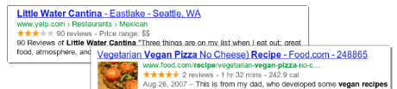
Vertical Search, Microformats and Rich Snippets
Vertical Search
Searching on certain topic / specific industry
E.g. books, news, products, videos, jobs, etc.
Rich Snippets
Additional data in the search result items
Microformats / microdata / RFDa
Add metadata / annotations to site content
E.g. author, business / organization, geo-location, product rating, event, video, review

Slide 37

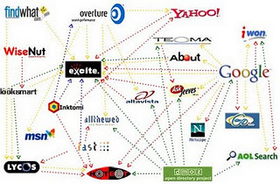
Special Search Channels
Special Search: Images, Video, Blogs, Mobile

Slide 38


Special Search Channels
SEO goes beyond the traditional text search
Special search channels should also be SEO optimized (vertical search)
Special search channels
Media search
Images and video
Blogs search
Mobile search
Non-Google search: Bing, Yahoo, Yandex, Baidu

Slide 39
Media Search Channels
Media channels bring traffic and backlinks
Photo Sharing
Flickr, SmugMug, Google Picasa, PhotoBucket, Facebook Albums, Google+ Albums, jAlbum, …
Google / Bing / Yahoo Image Search, …
Video Sharing
YouTube, Vimeo, Metacafe, DailyMotion, Blip.tv, PhotoBucket, Archive.org, VBOX7, …
Presentations
SlideShare, Slides.bg, SlideBoom, SlideServe, …

Slide 40
Other Search Channels
Blog search
Ensure your blog notifies the search engines for changes: http://rpc.pingomatic.com
Manual blog submit at: http://pingomatic.com
Integrate your blog with Twitter / Facebook / …
Mobile search
Mobile users are growing → you should have mobile-friendly version of your site
Register for location-aware services like Foursquare, Glympse , Gowalla, Yelp

Slide 41
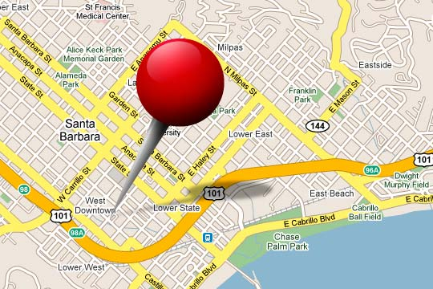
Local Search
Google Places, Facebook Places, Maps, etc.

Slide 42

Local Search
Local search can add more traffic to your site or business if you have a geo location (venue)
Be sure to register in Google, Bing and Yahoo
Register in the other local search engines
Places to register
Google Places
Facebook Places
Google Maps, Bing Maps, Yahoo Maps
Catalogs / directories like Yellow Pages

Slide 43

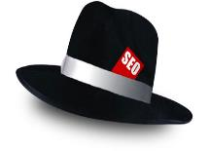
Black and White SEO
What is Black SEO and White SEO and How It Works?

Slide 44
White SEO
White SEO (white-hat SEO) techniques
Important sites hold rich and valuable content and have large community
Community members comment and share the site content everyday through their channels
White SEO techniques support the natural (organic) way of providing value
Publishing good articles and sharing them to interested auditory who like / share them
Being successful in SEO means using white SEO – officially recommended by the search engines

Slide 45
Black SEO
Black SEO (black-hat SEO) techniques
Officially forbidden by the search engines
Examples of black SEO techniques / SEO spam
Spamdexing (search engine spam)
Hidden text / hidden links / injected content
Buying / selling links / link farms
Scraper sites (spam sites, web scrapers)
Avoid using black SEO techniques!
You may get unlisted from the SERPs

Slide 46

Paid SEO
Performing Paid E-Marketing Campaigns

Slide 47

Paid e-Marketing and SEO
Many companies pay for visitors to their site
Pay-per-click programs
Google AdWords – pay for attracting visitors
Google AdSense – gat paid for showing ads
Microsoft adCenter
Yahoo Search Marketing
Link exchange programs
Mobile pay-per-click programs
Google Mobile Ads, Microsoft Mobile Banner

Slide 48
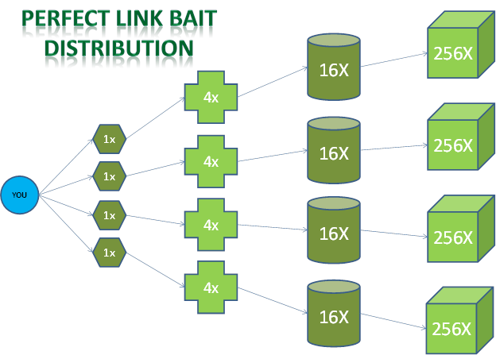
Link Bait (Viral) SEO
Creating Unique Content that Others Will Share

Slide 49
Link Bait (Viral) SEO
Link bait (viral) SEO is original marketing technique that works well for SEO
Create an unique content that lots of people will like and share, e.g. funny picture / story
Distribute it initially in the social networks
It will get shared and multiplicated like a virus
Ensure the link bait content links to your site with your keywords as anchors
Ensure the link bait content is hard to be copied outside of your site

Slide 50
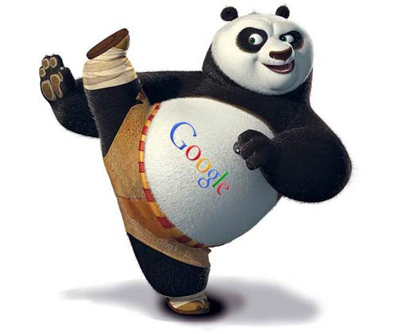
Google Panda / Penguin
What Changes Google are Introducing Recently?

Slide 51

Google Panda
Google Panda is an update in the Google's search algorithms
Aiming to increase the rank of the valuable sites and decrease the rank of low-quality sites
Based on machine-learning concepts (artificial intelligence algorithms)
May incorporate user behavior pattern analysis
Manual "+1" votes → better personalized search
Tracking through Toolbars, Analytics, Google+, …
Panda updates introduce changes constantly

Slide 52

Google Penguin
Google Penguin is an update to Google's search engine
Aimed to fight spammers
Aimed to decrease the rankings of sites used illegal techniques / black-hat SEO techniques
Link schemes (sell / purchase / exchange links)
Too many links with the same anchors
Keyword stuffing / hidden phrases / other spam
Cloaking (different content for Google and users)
Duplicated / stolen content

Slide 53
Introduction to SEO
?
?
?
?
?
Questions?
?
?
?
?
?
?
http://seocourse.telerik.com

Slide 54




Free Trainings @ Telerik Academy
C# Programming @ Telerik Academy
csharpfundamentals.telerik.com
Telerik Software Academy
academy.telerik.com
Telerik Academy @ Facebook
facebook.com/TelerikAcademy
Telerik Software Academy Forums
forums.academy.telerik.com

